Slide 1
Connecting to Various Data Sources in Power BI

Slide 2
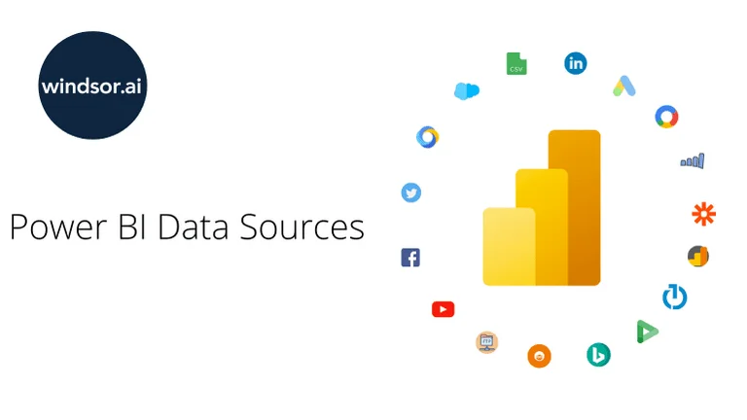
Power BI
Power BI is a business analytics tool developed by Microsoft that allows users to visualize data, share insights, and make data-driven decisions. It's widely used by organizations for creating interactive reports, dashboards, and analytics from a variety of data sources.

Slide 3
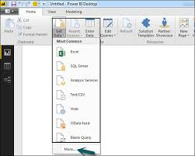
Data Sources in Power BI
1. Excel Files
Steps: Open Power BI Desktop.
Click on Get Data in the Home tab.
Select Excel from the list.
Browse to the location of your Excel file and click Open.
Select the sheets or tables you want to import and click Load or Transform Data to clean the data before loading

Slide 4
2. CSV/Text Files
Steps: Go to Get Data > Text/CSV.
Select the file and load it into Power BI.
Review the preview and adjust the settings if needed, then click Load or Transform Data.
3. SQL Server
Steps: Click Get Data and choose SQL Server from the list.
Enter the Server name and Database name.
Choose the authentication method (Windows or SQL Server authentication).
Select the tables or views you want to import.
Click Load to import the data.

Slide 5
4. Web Data
Steps: Select Get Data > Web.
Enter the URL of the web page that contains the data.
Power BI will try to recognize tables from the web page. You can choose the one you want and load it.
5. SharePoint Online List
Steps: Click Get Data > More > Online Services > SharePoint Online List.
Enter the SharePoint site URL and authenticate.
Select the list you want to load and click Load.

Slide 6
6. Azure Data Sources
Power BI supports several Azure services like Azure SQL Database, Azure Data Lake, Azure Blob Storage, etc.
Steps: Choose Get Data > Azure.
Select the relevant Azure service (e.g., Azure SQL Database, Azure Data Lake).
Provide the necessary credentials and details.
Select the data and click Load.
7. Google Analytics
Steps: Go to Get Data > Online Services > Google Analytics.
Log in to your Google Analytics account.
Select the account, property, and view you want to connect to.
Load the data.

Slide 7
8. Power BI Datasets
Steps: In Get Data, select Power BI datasets to reuse a dataset that is already published in the Power BI service.
9. ODBC Sources
Steps: Choose Get Data > ODBC.
Select the appropriate ODBC driver and enter the connection string for your database.

Slide 8
10. API/Dataflows
You can connect to APIs or dataflows via Power BI’s Web and OData connectors.
Steps: Select Get Data > Web or OData feed, then enter the API endpoint.
Authenticate and retrieve data as needed.
11. Other Services and Databases
Power BI also supports many other data sources such as Oracle, SAP HANA, MySQL, PostgreSQL, etc.
Steps: Go to Get Data > More, then select the specific database or service.
Provide credentials and configure the connection.

Slide 9

conclusion
In conclusion, Power BI provides a flexible and robust platform to connect, analyze, and visualize data from a wide range of sources. Whether you're working with local files like Excel and CSV, relational databases such as SQL Server and MySQL, cloud-based platforms like Azure, or even web data and APIs, Power BI makes it easy to bring data together into a single, cohesive view.

Slide 10


Thank you
ajaycraju98@gmail.com

